Slide 1
Dark Web Safari
By Thor Kristiansen

Slide 2
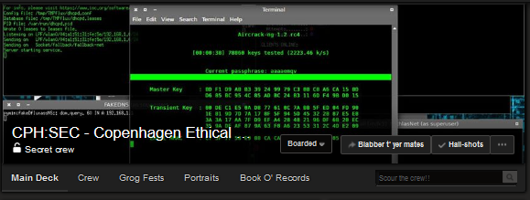
CPH:SEC - Copenhagen Ethical Hacking Club
Join US on Facebook:
Https://www.facebook.com/groups/CPHethicalHacking/

Slide 3
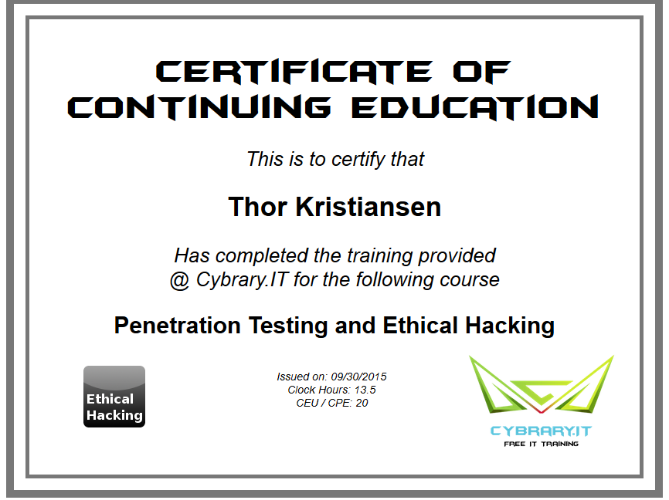
$Whoami
IT-Tech Graduate & Ethical Hacker
Founder of CPH:SEC, formerly KEA Pen-Test Club
Cybrary.IT ”Penetration Testing & Ethical Hacking” Certified

Slide 4
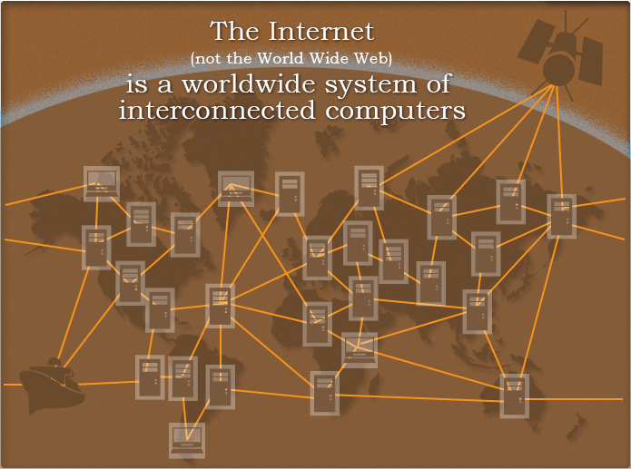
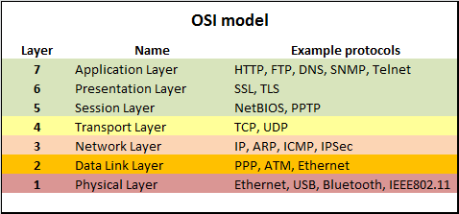
WEB vs Internet

Slide 5
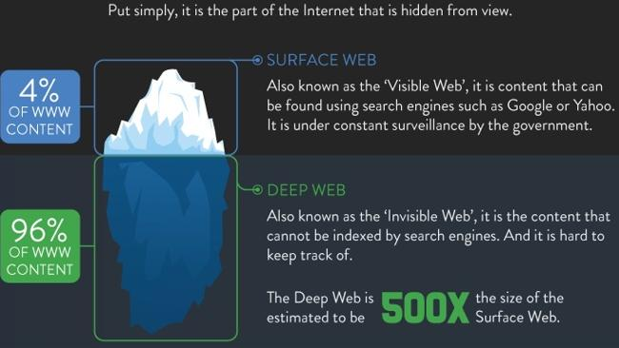
Surface Web and Deep Web

Slide 6
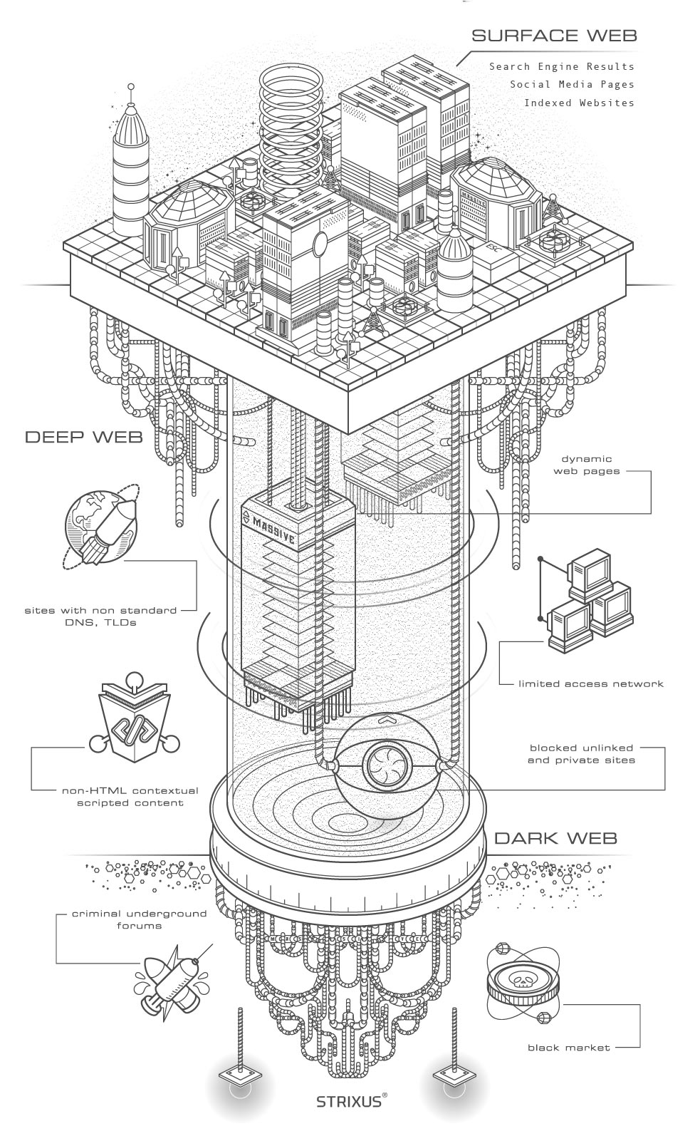
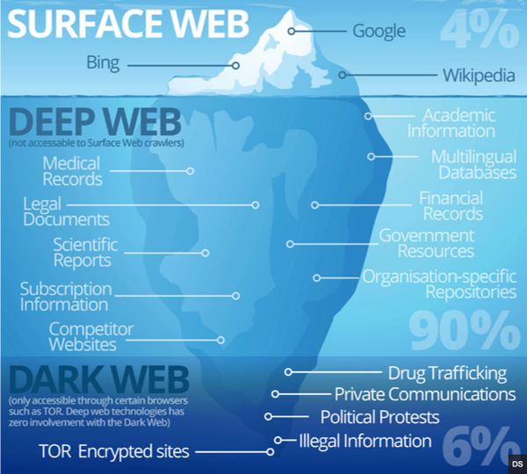
Surface, Deep & Dark WEB

Slide 7
Deep Web Myths
It is "Scary" or "Dangerous"
It is immense (only 0,3% )
Only Criminals use it
Red Rooms* are everywhere (*live murder room)
You can "stumble" on scary sites
The Deep Web and Dark Web are the same things
You will get arrested for accessing it ( - only in North Korea)

Slide 8

Tor Routing

Slide 9
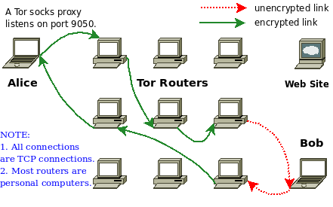
How Tor Works

Slide 10
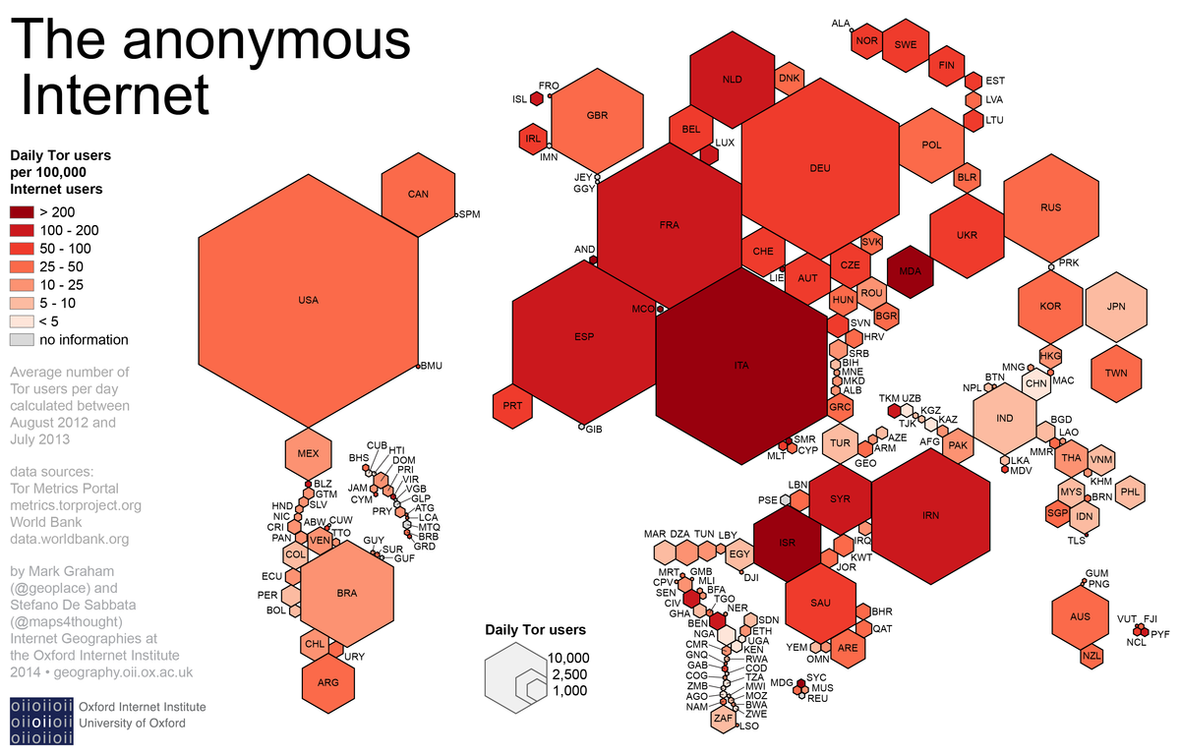
Tor Users

Slide 11
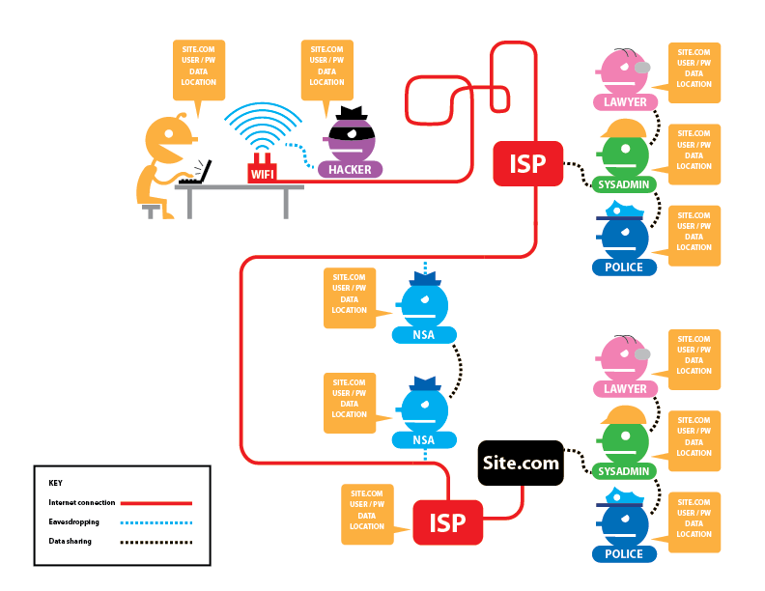
Who Can See what?
Tor and HTTPs

Slide 12
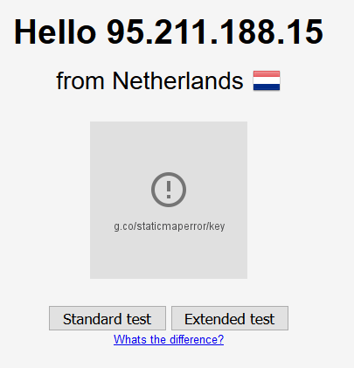
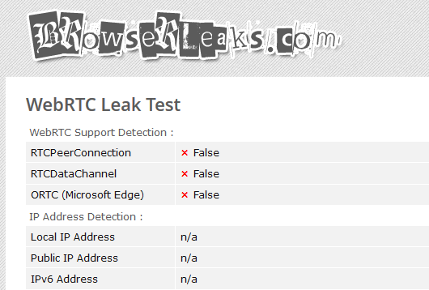
Privacy Tests
https://www.dnsleaktest.com/
https://browserleaks.com/webrtc

Slide 13
Dark Web Live
Fasten Your Seatbelts

Slide 14
Resources
How Tor Works: https://www.youtube.com/watch?v=LAcGiLL4OZU
Deep Web Academy: https://www.youtube.com/channel/UCJ31aJo8U-ZaRnZ4Y27so_Q
Blockchain (Bitcoin): http://blockchain.info/
Find Secure VPN: https://thatoneprivacysite.net/

Slide 15
EOF
Thank You for Listening!

